Slide 1
Abstract Data Structure
Unit-06

Slide 2
An abstract data structure (ADS) is a theoretical concept within computer science that specifies how data is organized, stored, and manipulated in a computer system, without delving into the specifics of its implementation. It provides the necessary operations to access and manipulate the data it contains, focusing on what operations are performed rather than how these operations are implemented. Abstract data structures form the foundation for designing and analyzing algorithms and are crucial for efficient data processing and storage.

Slide 3
Arrays: A collection of elements identified by index or key, storing elements of the same type. Arrays allow fast access to elements but can be inefficient for insertion and deletion operations.
Linked Lists: Consist of nodes where each node contains data and a reference (or link) to the next node in the sequence. This structure allows for efficient insertion and deletion of elements.
Stacks: A collection that follows the Last In, First Out (LIFO) principle, where the most recently added element is the first to be removed. Stacks are useful for tasks such as reversing data or parsing expressions.
Queues: A collection that follows the First In, First Out (FIFO) principle, where the first element added is the first to be removed. Queues are used in scenarios like task scheduling and buffering.
Trees: A hierarchical data structure with a root value and subtrees of children with a parent node, represented as a set of linked nodes. Trees are used in databases, file systems, and for efficient searching and sorting.
Graphs: A collection of nodes (or vertices) connected by edges. Graphs can represent networks, such as social networks or transportation grids, and are used in various algorithms, including searching and pathfinding.
Hash Tables: Implements an associative array, a structure that can map keys to values. Hash tables are highly efficient for lookup and insertion operations and are widely used in database indexing.

Slide 4
Linked Lists

Slide 5
Linked lists are fundamental data structures that consist of a series of nodes, where each node contains data and a reference (or link) to the next node in the list. The structure allows for efficient insertion and deletion of elements because these operations do not require the elements to be contiguous in memory. Linked lists come in several varieties, including singly linked lists, doubly linked lists, and circular linked lists, each offering different advantages for specific situations.

Slide 6
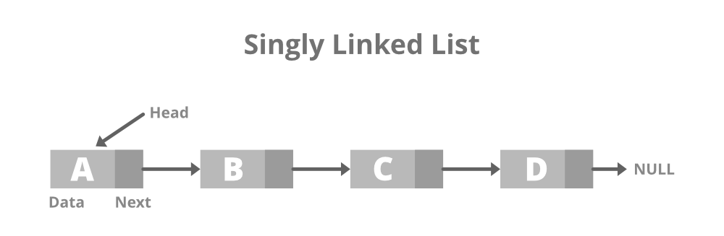
Singly Linked Lists
In a singly linked list, each node points to the next node in the sequence, with the last node pointing to null, indicating the end of the list. This structure is simple and uses less memory per node (since there's only one pointer), but it can only be traversed in one direction.
Use Cases for Singly Linked Lists:
Implementation of stacks and queues: Singly linked lists are well-suited for these data structures since elements are added and removed from the ends.
Lightweight and simple storage needs: When the data structure's complexity and memory usage are critical factors, singly linked lists offer a straightforward and efficient solution.

Slide 7
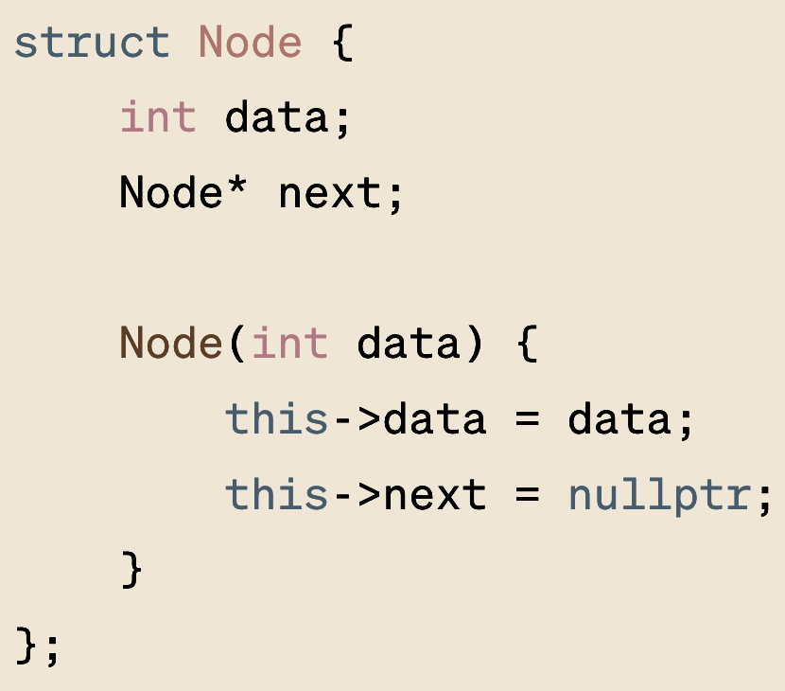
Singly Linked Lists: Implementation
Can you implement insert and delete?
insert:
If the current node is last node, assign new node to
this->next
If the current node is some intermediate nodes, traverse to until you find the last node, and now assign the new node
delete:
Check if the value matches
If matched: delete the node and join two neighboring nodes if the node is intermediate
If matched: delete the node and assign this->next a nullptr to the previous node if the node to be deleted is the last node

Slide 8
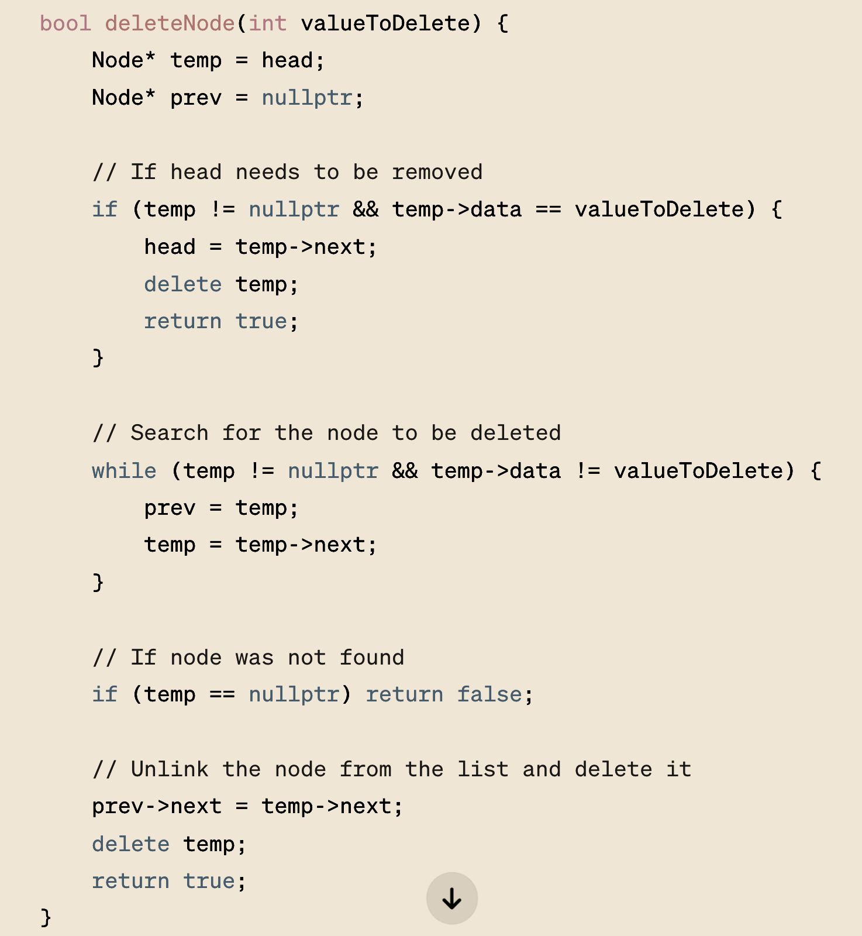
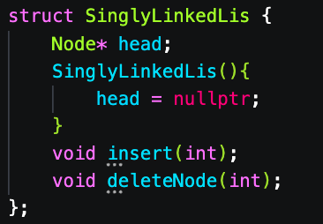
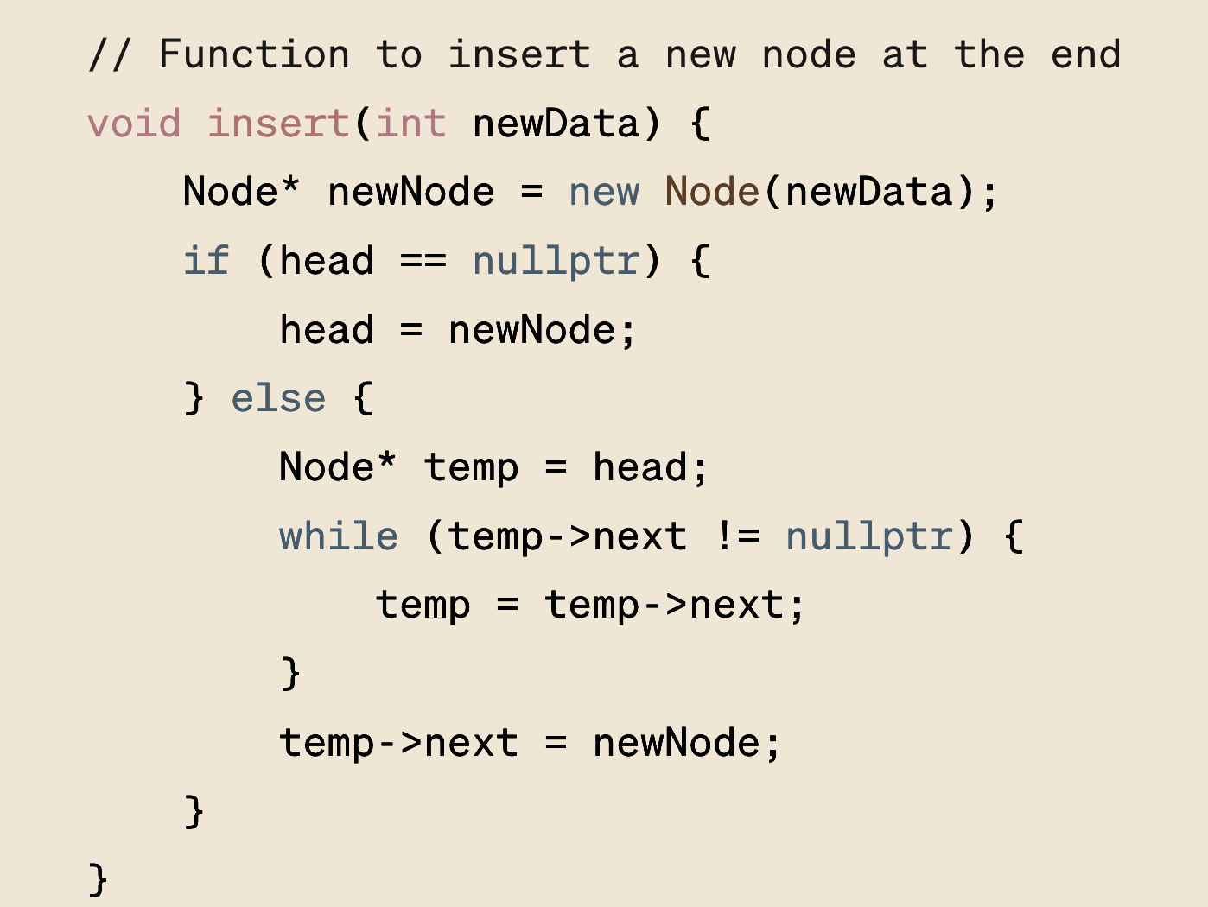
Singly Linked Lists: Implementation

Slide 9
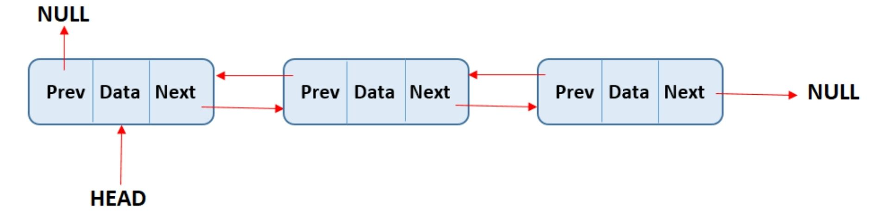
Doubly Linked Lists
Doubly linked lists allow each node to have two links: one pointing to the next node and one to the previous node. This bidirectional traversal capability makes some operations more efficient, such as deletion of a node when only the node to be deleted is given.
Use Cases
Navigational systems: The ability to move forward and backward through the list is useful in applications where users need to navigate through a set of items, such as a web browser's history.
Implementing data structures that require both ends access: Doubly linked lists are ideal for implementing data structures like deques (double-ended queues) that require efficient operations on both ends of the sequence.

Slide 10
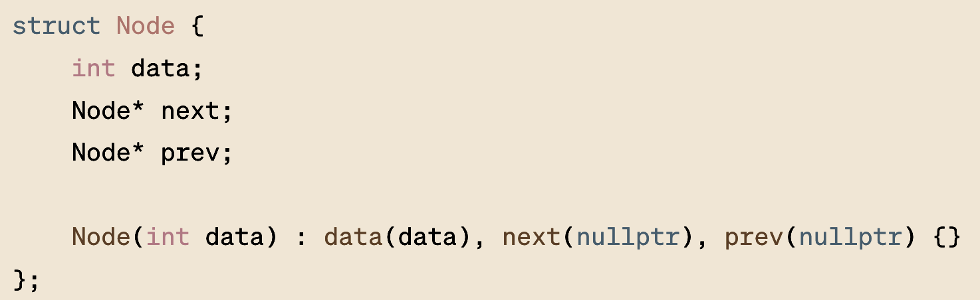
Double Linked Lists: Implementation
How do we implement insert, delete?

Slide 11
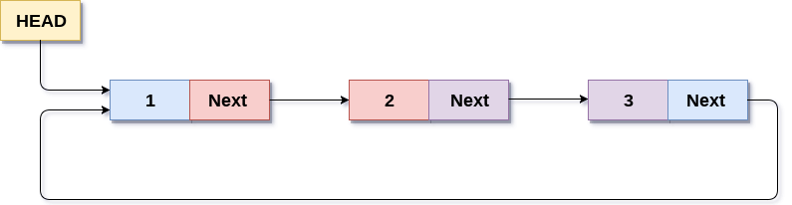
Circular Linked Lists
Circular linked lists are a variation of linked lists where the last node points back to the first node, forming a circle. This can be applied to both singly and doubly linked lists. Circular linked lists are useful for cyclically accessed data, where the list needs to be looped through repeatedly without needing to find the end.
Use Cases
Implementing round-robin schedulers: In operating systems, circular linked lists can be used to manage processes in a round-robin scheduling algorithm efficiently.
Music playlists or slideshow applications: Where the items (e.g., songs, images) need to be looped through continuously without interruption.

Slide 12
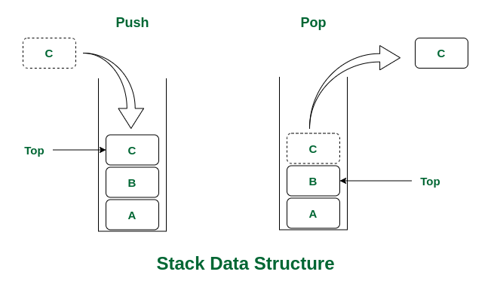
Can you use previous concept and implement following Stack?

Slide 13
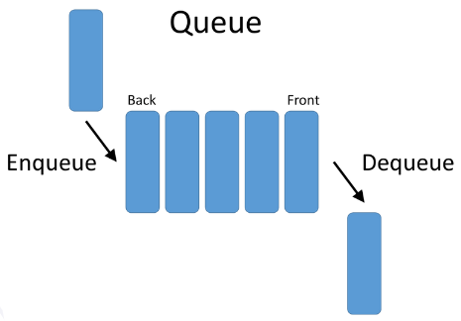
Can you use previous concept and implement following Stack?

Slide 14
Fun Exercise : Simulating Function Call Stack
Objective: The main goal of this exercise is to simulate the call stack mechanism that happens in the background when functions call other functions, including recursive function calls. Visualize the LIFO (Last In, First Out) nature of the call stack.
Step 1: Define the Stack Node
Each node in the stack will represent a function call, containing the function's name and any relevant parameters or local variables.
Step 2: Implement the Call Stack
Create a CallStack class to manage the function calls. Include methods to push a function onto the stack (simulating a function call) and pop a function from the stack (simulating returning from a function).
Step 3: Demonstrate with a Recursive Function
Use the CallStack to simulate a simple recursive function, such as calculating factorial, to visualize how the call stack changes with each function call.

Slide 15
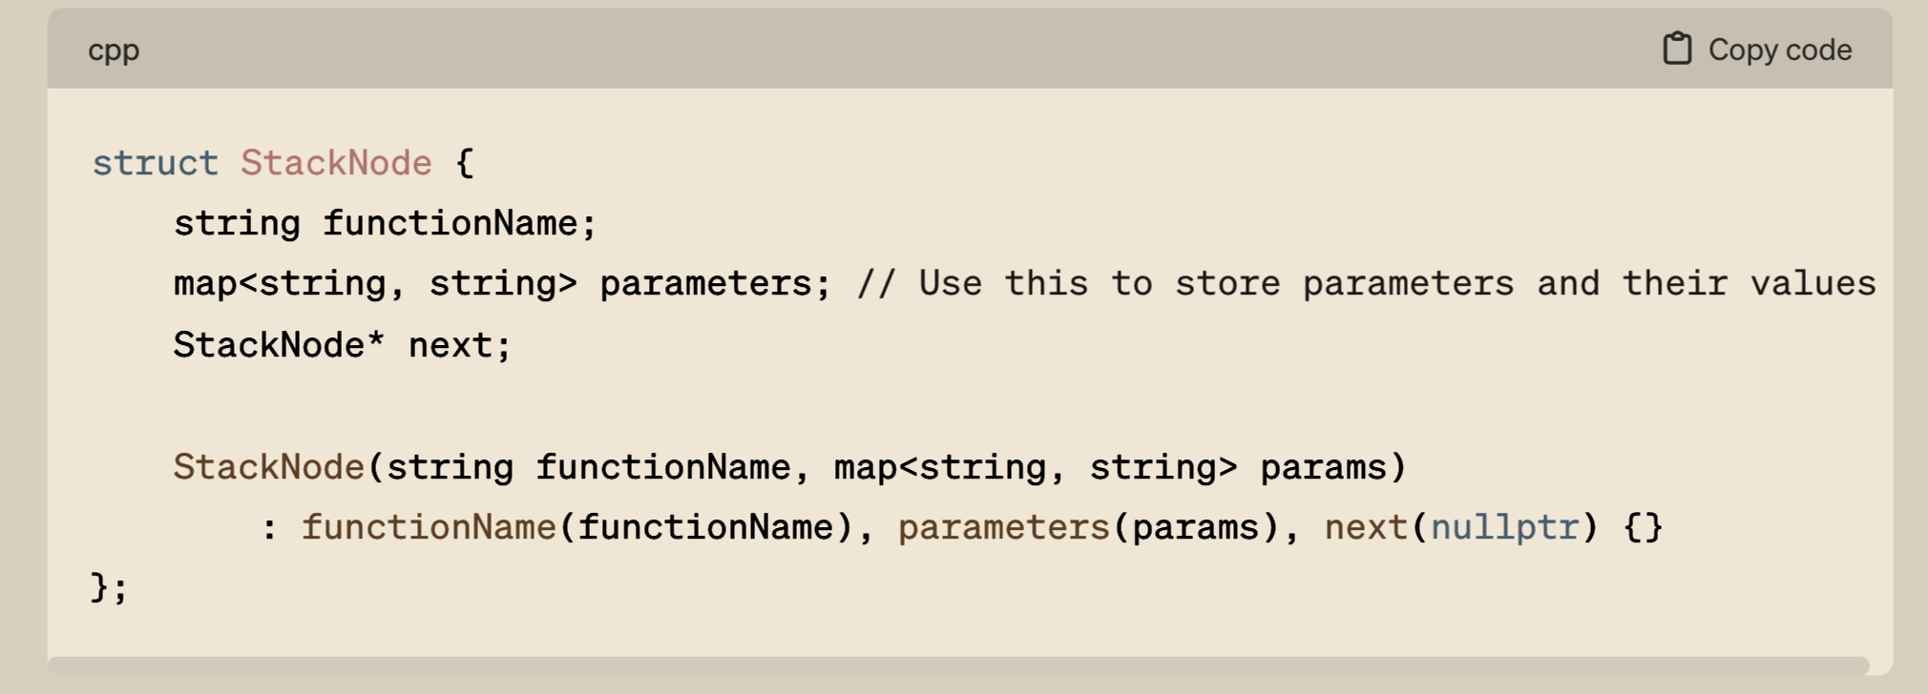
Fun Exercise : Simulating Function Call Stack

Slide 16
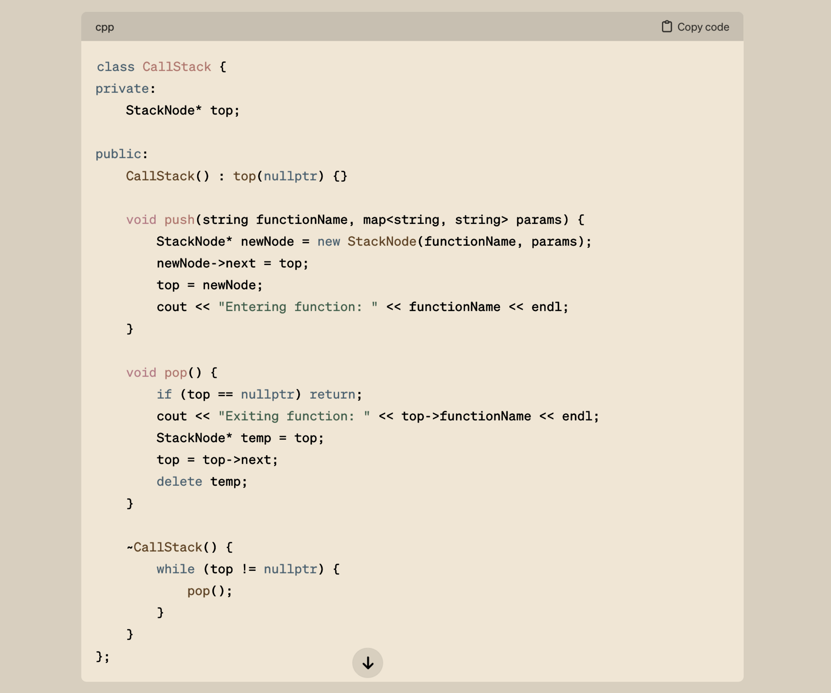
Fun Exercise : Simulating Function Call Stack

Slide 17
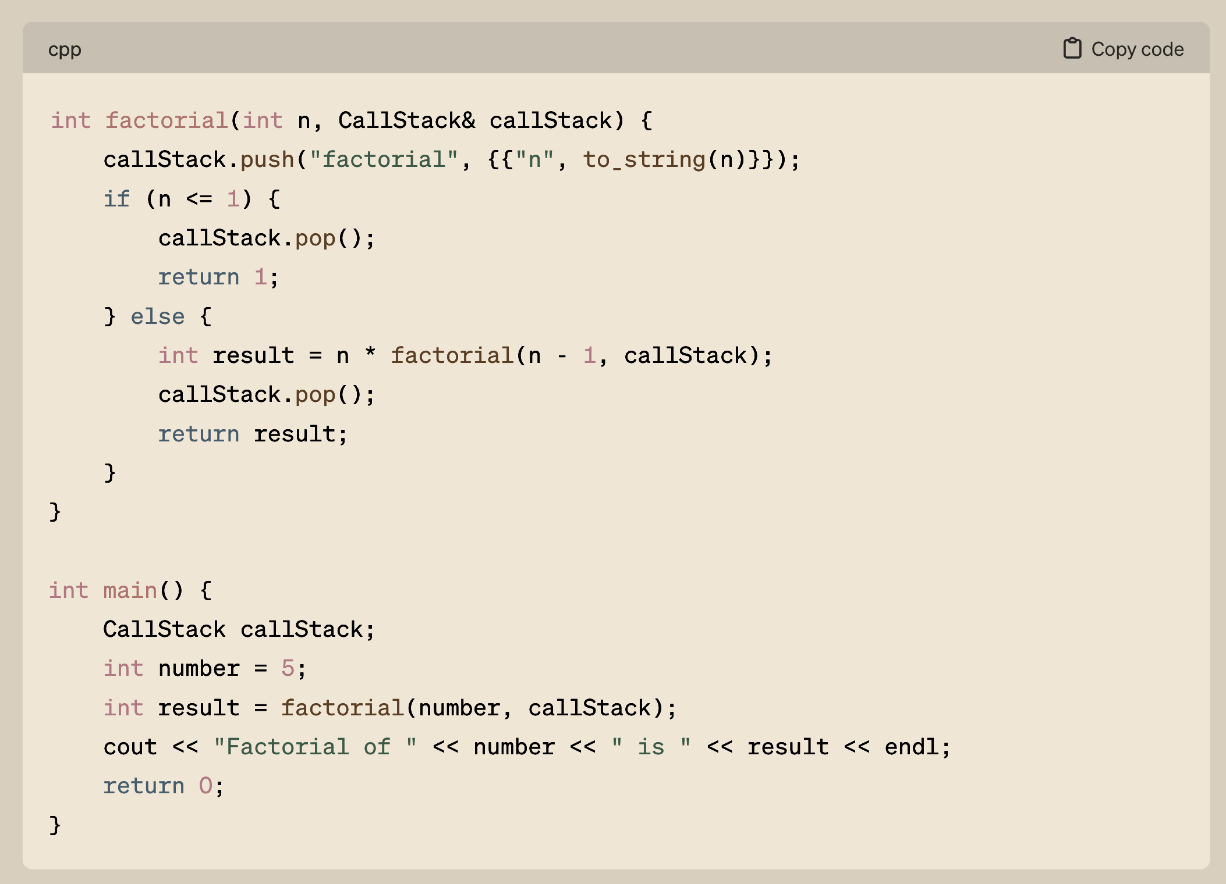
Fun Exercise : Simulating Function Call Stack

Slide 18
Heap
The heap is a specialized tree-based data structure that satisfies the heap property. In a heap, for any given node C, if P is a parent node of C, then the key (the value) of P is either greater than or equal to (in a max heap) or less than or equal to (in a min heap) the key of C. The node at the "top" of the heap (the root node) contains the largest key (in a max heap) or the smallest key (in a min heap). Heaps are crucial in implementing priority queues, where the queue's element with the highest priority is always at the front.

Slide 19
Priority Queues | For processing tasks based on priority, not order, crucial in operating systems, network routers, and simulations.
Sorting | Heapsort utilizes heaps for efficient, in-place sorting, beneficial for large datasets.
Graph Algorithms | Improves computational efficiency in algorithms like Dijkstra's and Prim's by selecting the next node to process.
Stream Processing | Maintains top elements in data streams, useful in real-time analytics and monitoring systems.
Memory Management | Used in memory allocation and garbage collection in operating systems to prevent fragmentation.
Data Compression | Builds Huffman trees for efficient encoding and decoding in compression algorithms.
Load Balancing | Distributes computing and network loads to optimize resource use and minimize response times.
Event Simulation | Manages event schedules in simulations, ensuring efficient processing of upcoming events.

Slide 20
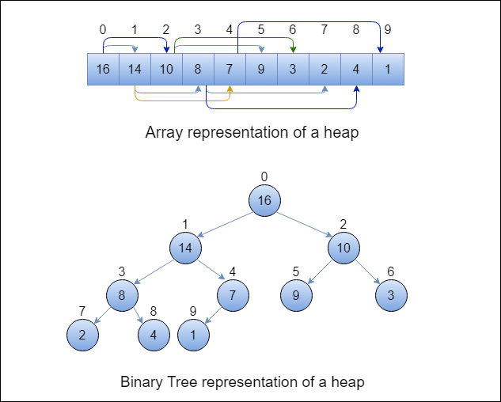
Heap
In a heap, for any given node C, if P is a parent node of C, then the key (the value) of P is either greater than or equal to (in a max heap) or less than or equal to (in a min heap) the key of C.

Slide 21
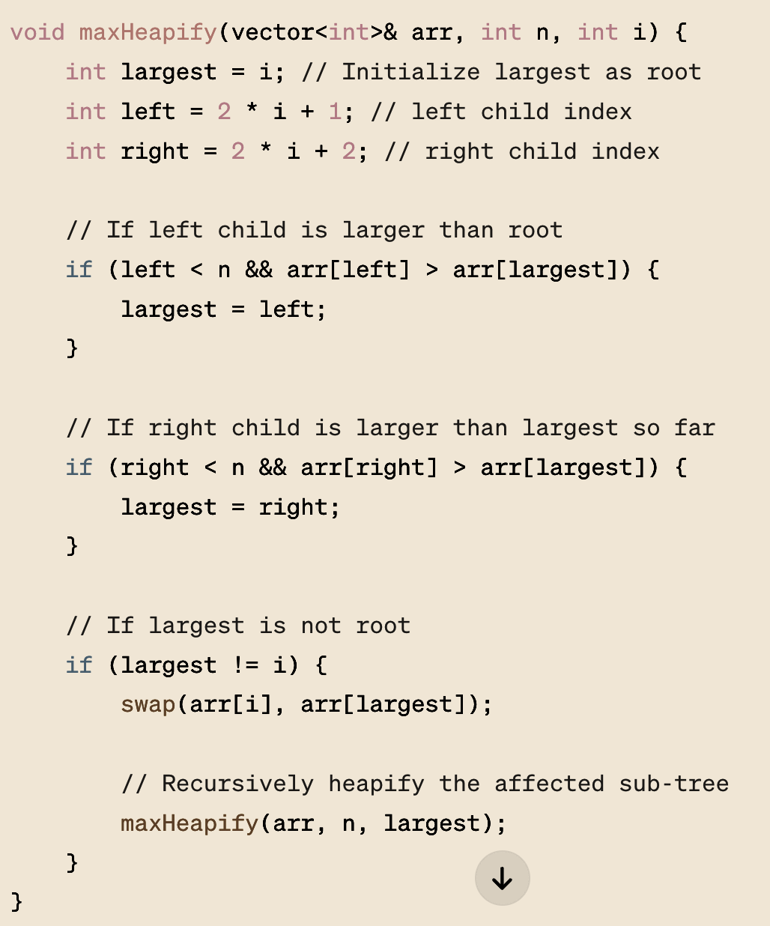
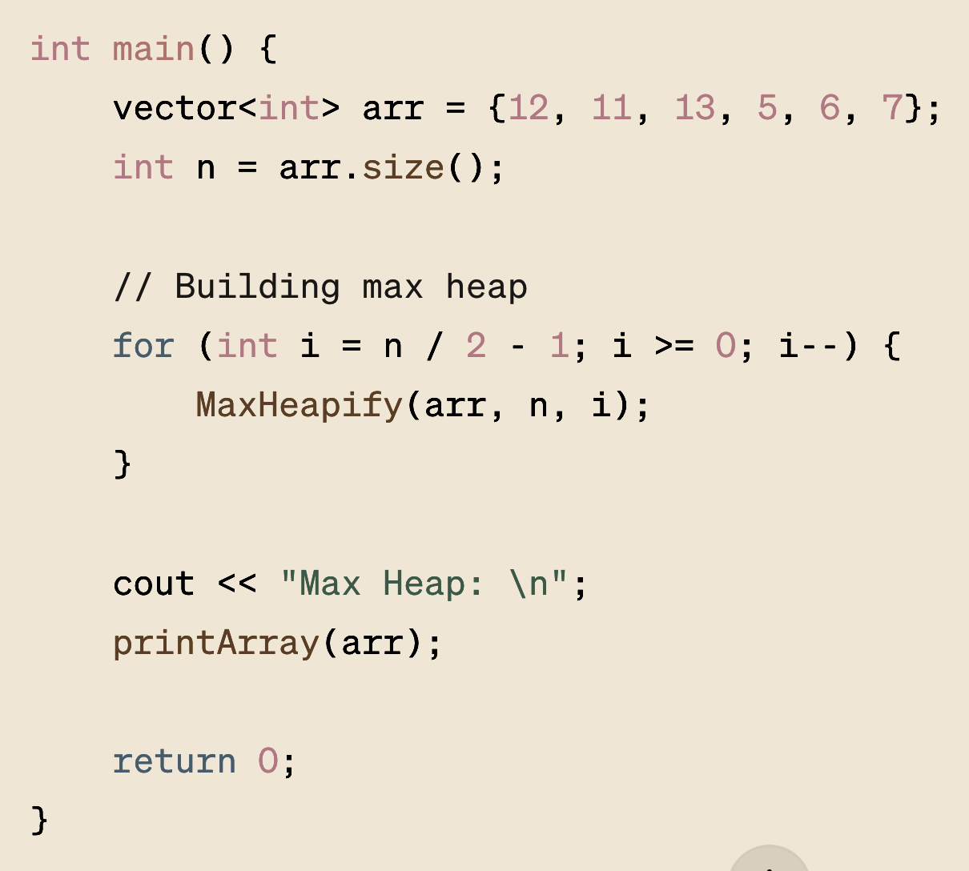
Max-Heapify
Questions…
What is the complexity of maxHeapify, delete, and insertion?
(YOU HAVE TO FIND THESE ANSWERS)

Slide 22
The Last Stone Weight
https://leetcode.com/problems/last-stone-weight/description/
https://leetcode.com/problems/last-stone-weight-ii/description/

Slide 23
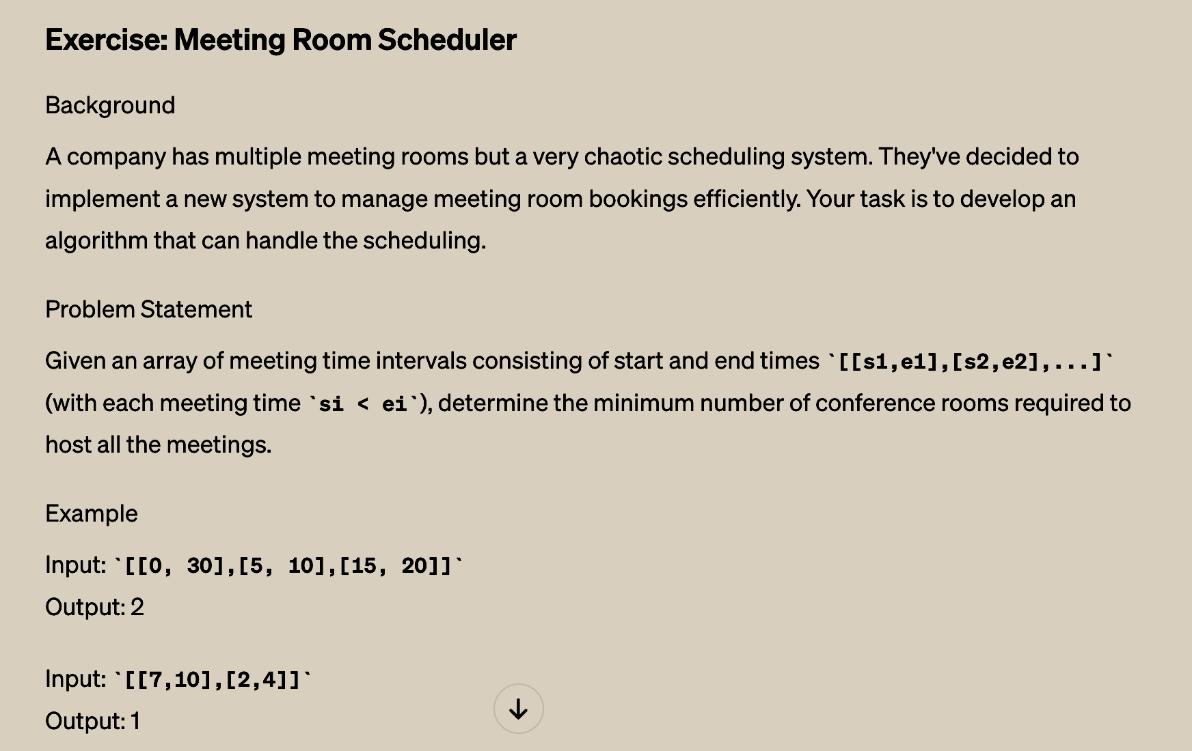
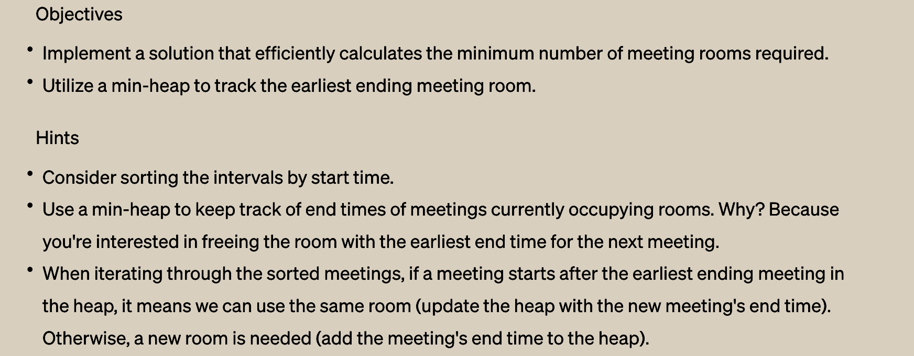
Preparing y’all for the job interview……

Slide 24
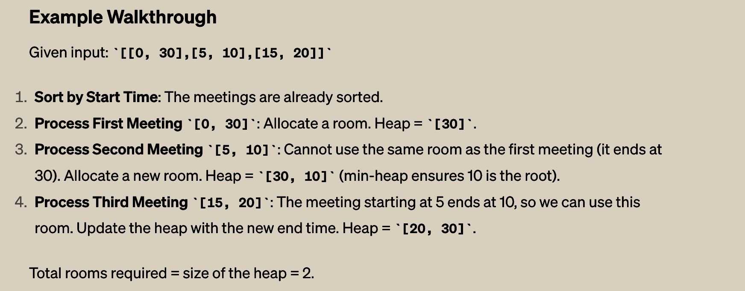
Preparing y’all for the job interview……

Slide 25
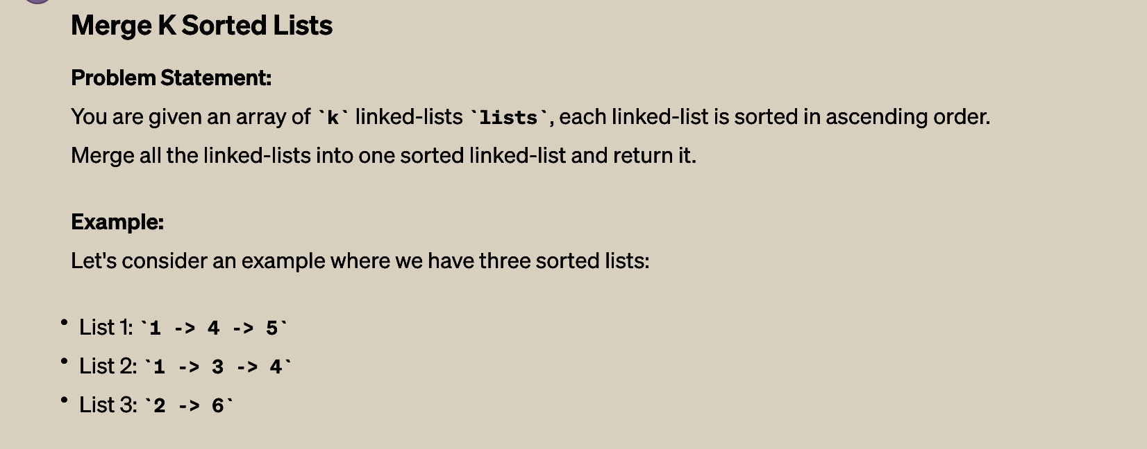

Preparing y’all for the job interview……

Slide 26
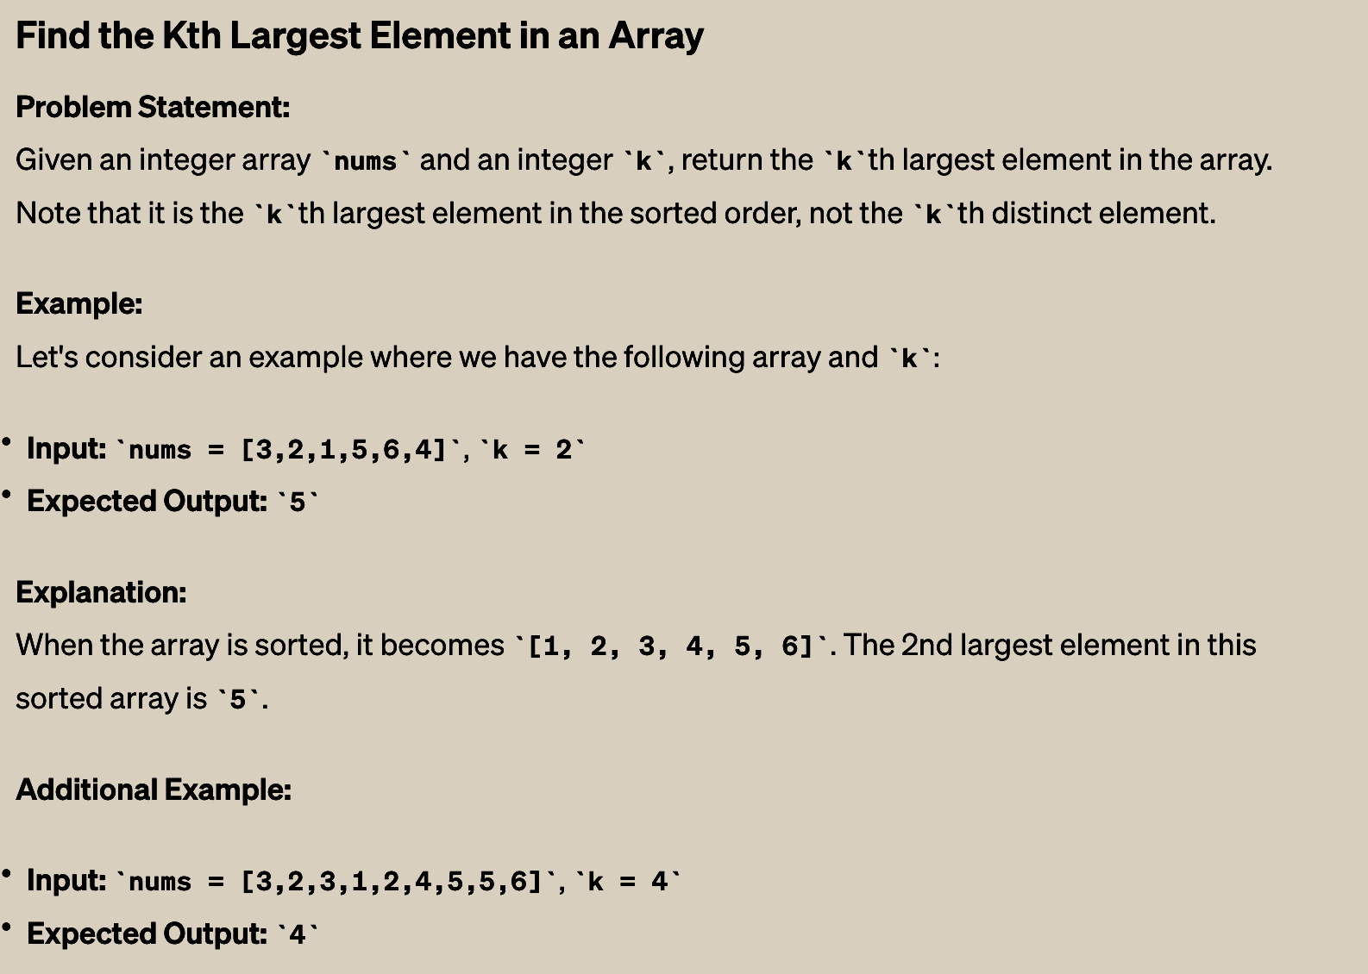
Preparing y’all for the job interview……

Slide 27
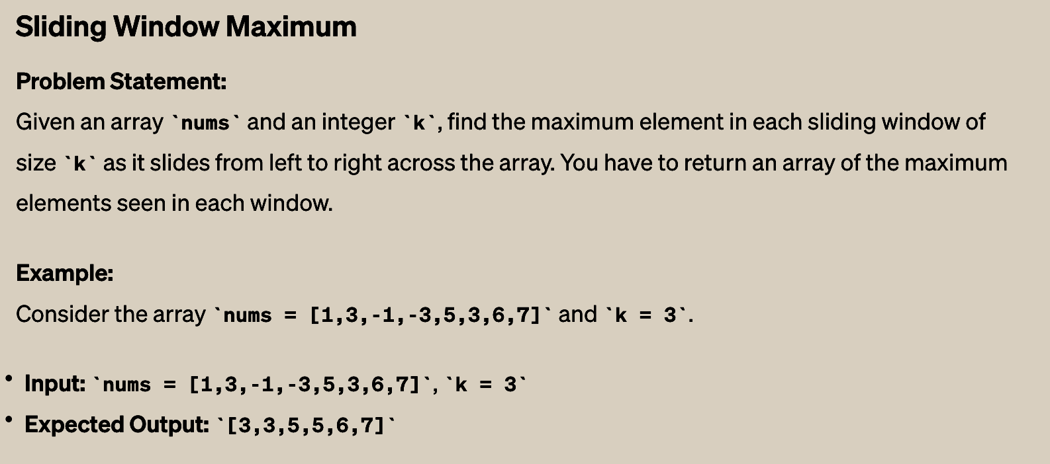
Preparing y’all for the job interview……

Slide 28
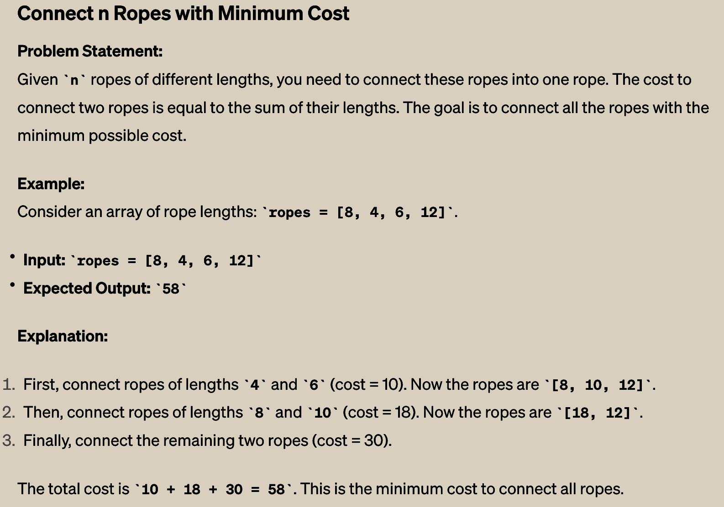
Preparing y’all for the job interview……

Slide 29
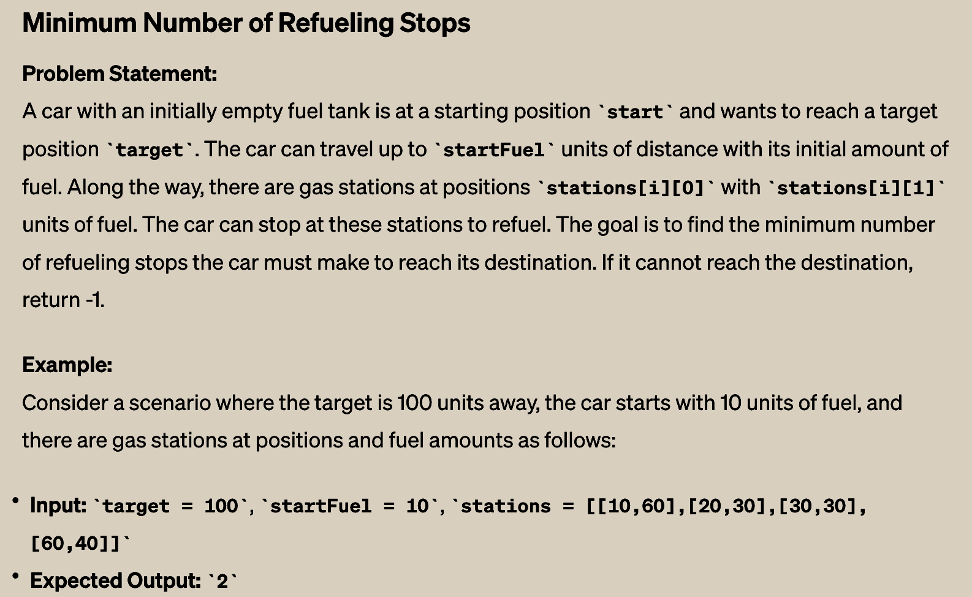
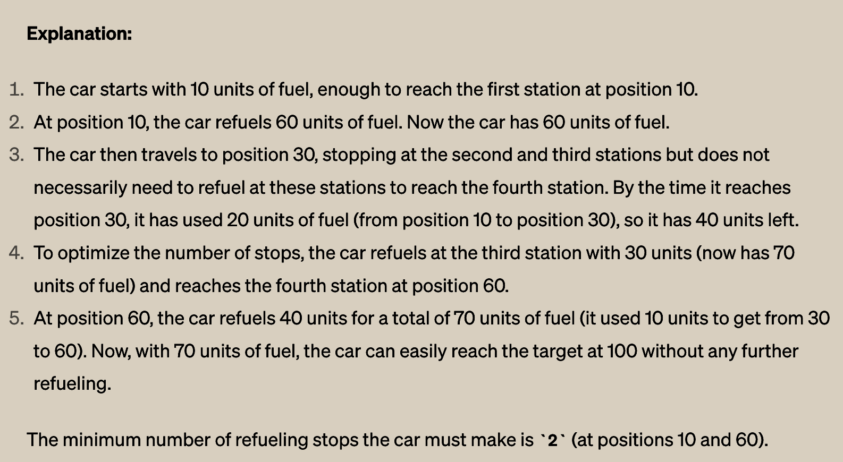
Preparing y’all for the job interview……

Slide 30
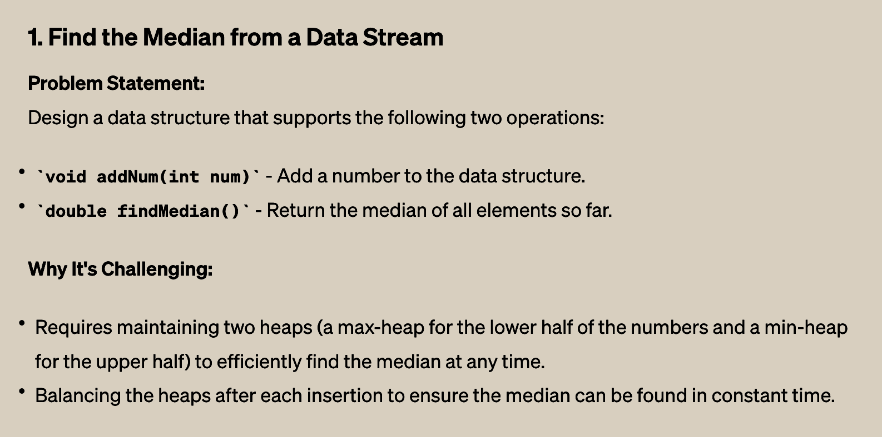

Preparing y’all for the job interview……

Slide 31
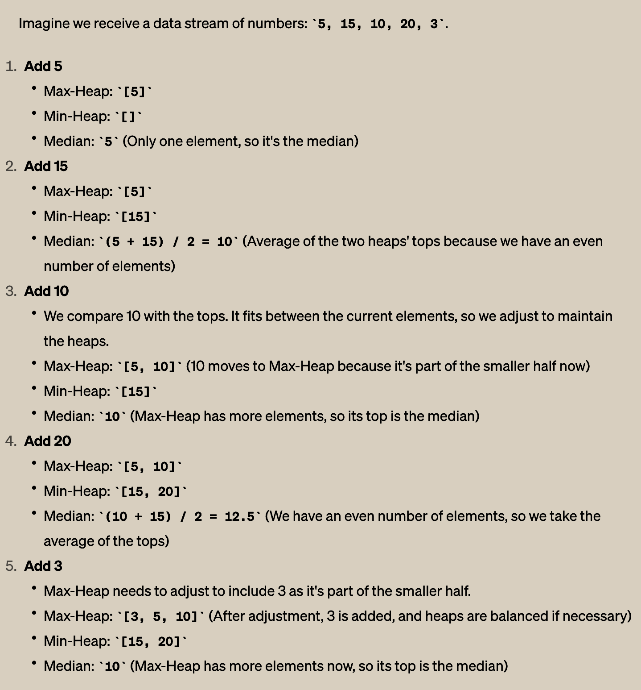
Preparing y’all for the job interview……

Slide 32
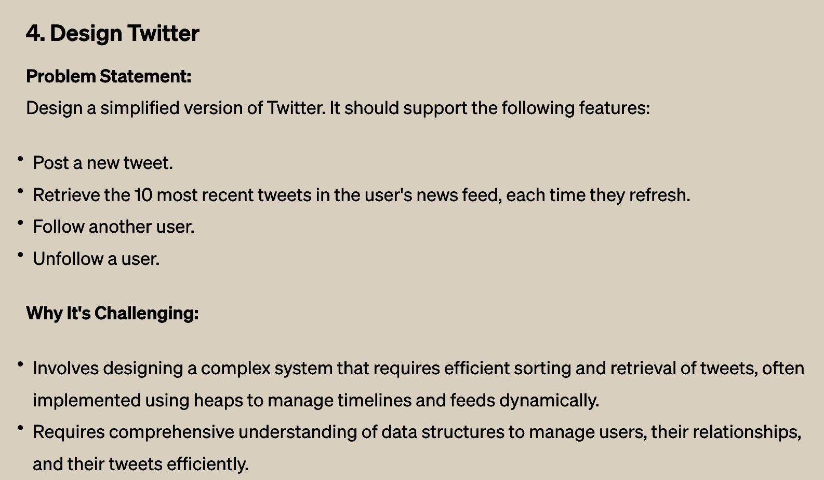
Preparing y’all for the job interview……
REVIVE

Slide 33
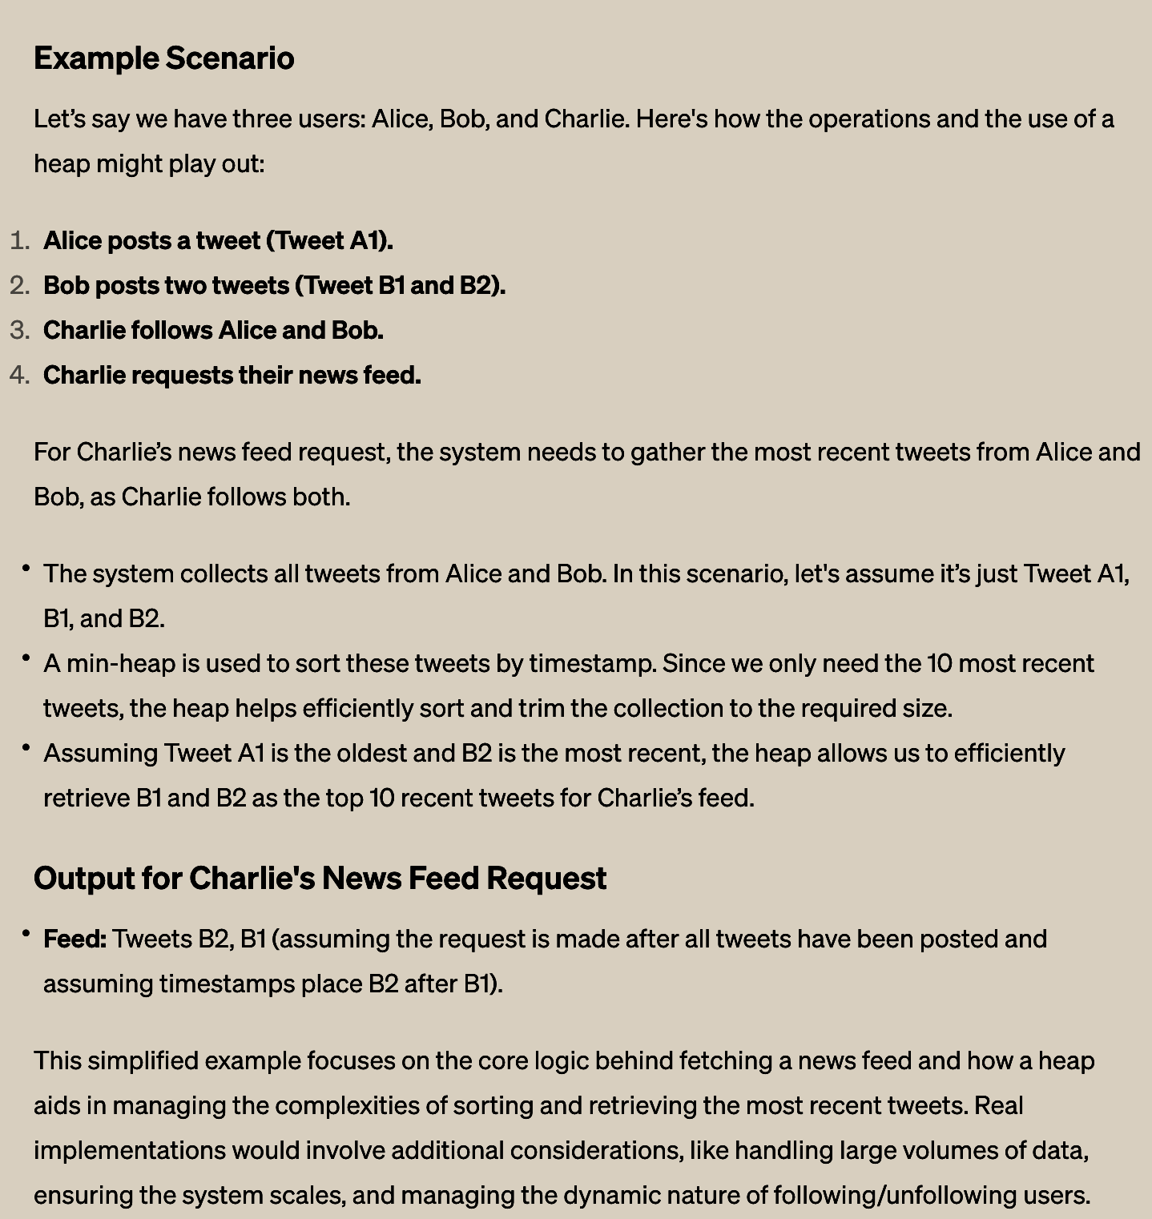
Preparing y’all for the job interview……

